Slide 1
QMST 5332 Paper Review:
Optimizing Fire Station Locations for the Istanbul Metropolitan Municipality
Presented by: Josh Hershman, Ruchi Kukde, Neeraj Panta, and Shefalika Upadhyay

Slide 2
Introduction
Istanbul Metropolitan Municipality (IMM) issued challenges to researchers for public works improvement
City of 13M people, centuries of religious and cultural heritage
790 mutually exclusive districts needing coverage
Cannot afford slow service times anywhere in city
Need to achieve 5 minute response time

Slide 3
Introduction, Continued
Researchers employed literature review
Set-covering cost-minimization problem
Maximal coverage-maximization problem
Both types of problem very common amongst scientific community
Began by collecting historical & GIS data to begin to visualize problem

Slide 4
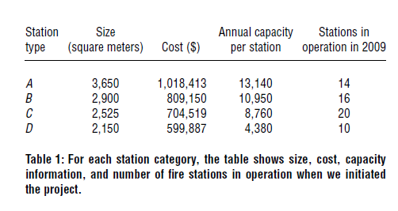
Solution Approaches : Data Acquisition
Historical fire incident data: 1994–2006
60 active Fire stations
37 Fire Stations : located on the European side
23 : located on the Asian side of the city
A, B : Referred as centers
C,D : Referred as squads/smaller outposts
Use fire incidents recorded by IMM as service requests issued from each subdistrict.

Slide 5
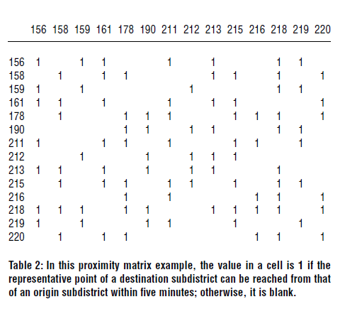
Data Acquisition, Continued
Use ArcGIS, for working with maps and geographic information, to facilitate data collection and processing for the 2 models.
Use network analysis tools to calculate travel times between sub districts of the city in both urban and rural areas.
We calculate the time it takes a firefighting vehicle to traverse the respective road segment.
Using ArcGIS, we first develop a map of Istanbul with its 40 districts and 790 subdistricts.

Slide 6



Mathematical Model
Model 1: Set Covering Model
Step 0: Gather input data
Step 1: Define decision variables
Step 2: Objective: Minimize the cost of opening fire stations
Objective function:

Slide 7
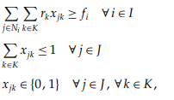
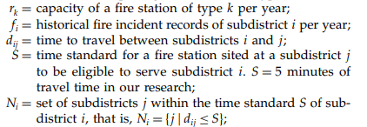
Mathematical Model
Constraint to ensure that the right type of station is opened to respond to service requests from each subdistrict
Model 1: Set Covering Model
Step 3: Constraints
Constraint that only one type of fire station is opened in a subdistrict
Constraint representing that decision variable of locating a fire station in a subdistrict is binary

Slide 8

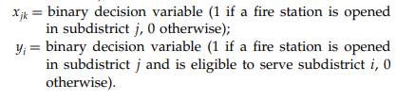

Mathematical Model, Continued
Model 2: Maximal covering model
Step 0: Gather input data
Step 1: Define decision variables
Step 2: Objective: Maximize the coverage of service requests in each subdistrict
Objective function:
l

Slide 9
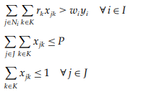
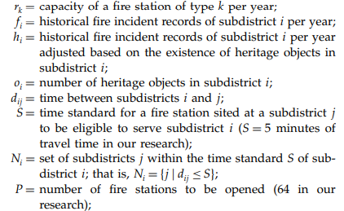

Mathematical Model
Constraint to ensure that the right type of station is opened to respond to service requests from each subdistrict
Step 3: Constraints
Constraint that number of fire stations opened is within the set limit
Constraint that only one type of fire station is opened in a subdistrict
Constraint representing that decision variables of opening fire stations in a subdistrict and covering service requests in sub districts are binary

Slide 10
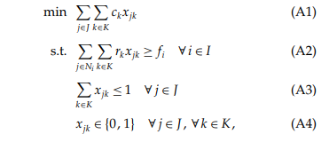
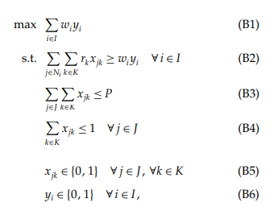
Mathematical Models
Set Covering model Maximal Covering model

Slide 11

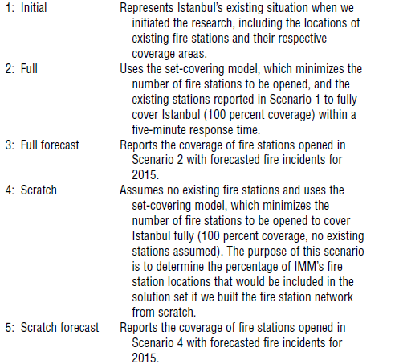
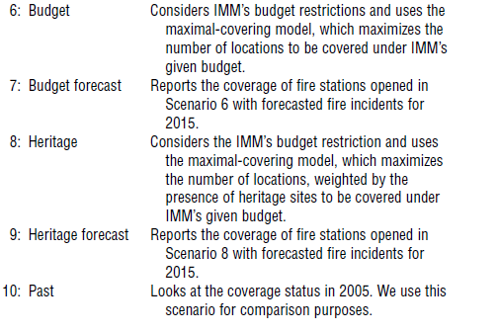

Solution Approaches : Scenario Analysis

Slide 12
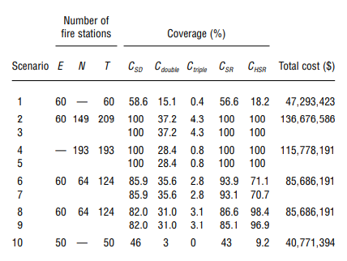
Results
For each scenario, three aspects of coverage were evaluated.
(E - Existing, N - New & T - Total) Number of Fire Stations
CSD - Describes the percentage of sub districts covered.
Cdouble - the percentage of sub districts covered two times.
Ctriple - the percentage of sub districts covered three times.
Cdouble , Ctriple are used to determine the percentage of sub districts within a five-minute travel time of at least two and three fire stations.
CHSR - Describes the Heritage service requests

Slide 13
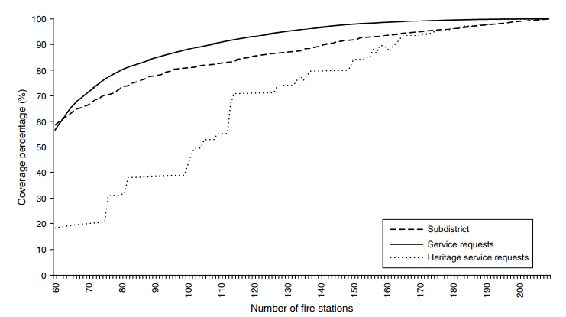
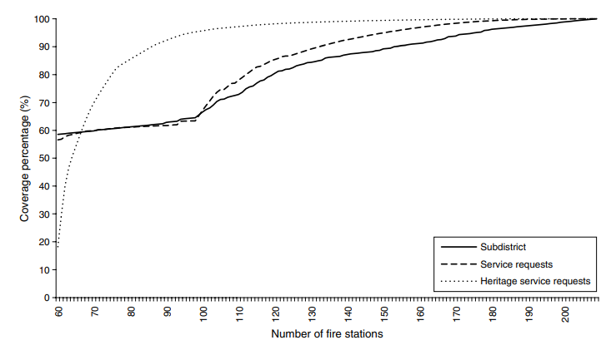
Results, Continued
Sensitivity Analysis described by Figure shows an increase in all three coverage measures as the number of fire stations increases. An additional fire station will improve coverage by less than 1 percent beyond 38 fire stations.
Sensitivity Analysis described by Figure shows a dramatic increase in heritage service request coverage when 35 new fire stations were added, whereas the service requests and subdistrict coverage remain the same
Both Figures indicate that cost-versus-service level (i.e., coverage percentage) trade off because opening a new fire station is linear relative to the number of new stations; in addition to cost of land, the station size and equipment size are fixed since we are working with IMM. These results provide a relation between cost and service levels.

Slide 14
Conclusions
10 solution scenarios generated by research group
Focused on cost and coverage
Were able to generate 100% coverage in some models
IMM council chose cost-constraint model
Budgetary concerns

Slide 15
Conclusions, Continued
Chosen solution increased coverage ~25%
50s% -> 80s%
Each additional fire station added .4%
Effective and practical solution that satisfied all parties involved
Aktas, E., Ozaydin, O., Bozkaya, B., Ulengin, F., & Onsel, S. (2013). Optimizing Fire Station Locations for Istanbul Metropolitan Municipality. Interfaces, 43, 1-16. 10.1287/inte.1120.0671.

Slide 16

Questions

